Slide 2
Active contours : Goal

Slide 3
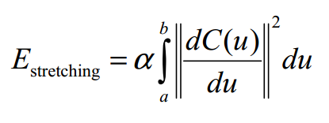
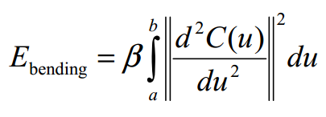
Active contours – Energy minimisation Internal energy

Slide 4
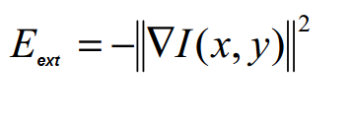
Active contours – Energy minimisation External energy

Slide 5
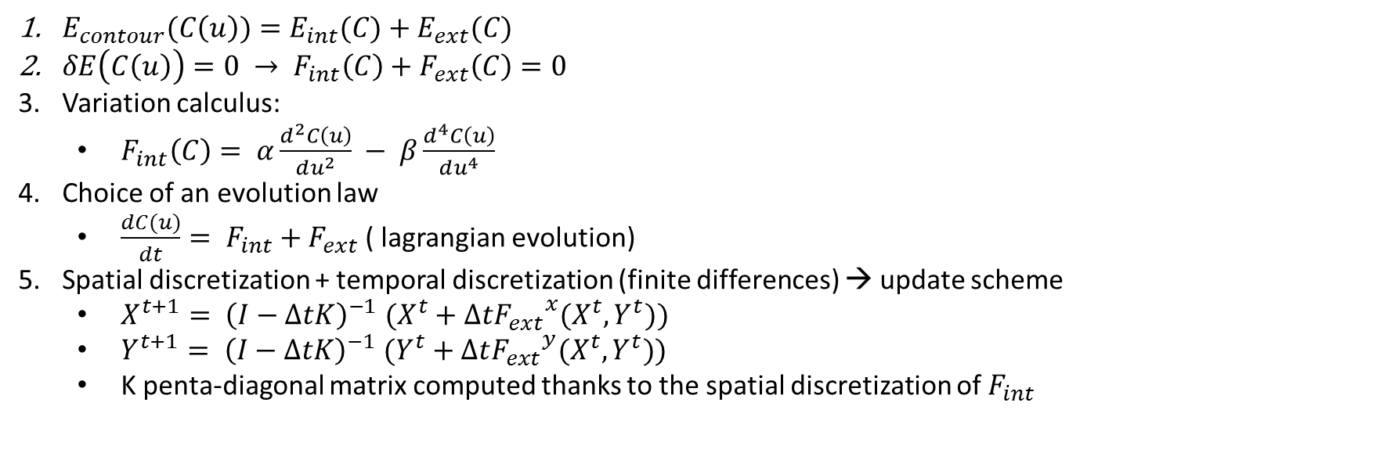
Active contours : Update scheme
$E_{contour}(C\left(u\right))=E_{int}(C)+E_{ext}(C)$
$δE\left(C\left(u\right)\right)=0 → F_{int}\left(C\right)+F_{ext}\left(C\right)=0$
Variation calculus:
$F_{int}\left(C\right)= α\frac{d^{2}C\left(u\right)}{du^{2}} − β\frac{d^{4}C\left(u\right)}{du^{4}}$
Choice of an evolution law
$\frac{dC(u)}{dt}= F_{int}+F_{ext}$ ( lagrangian evolution)
Spatial discretization + temporal discretization (finite differences) → update scheme
$X^{t+1}{= \left(I−ΔtK\right)}^{−1}(X^{t}+Δt{F_{ext}}^{x}(X^{t},Y^{t}))$
$Y^{t+1}{= \left(I−ΔtK\right)}^{−1}(Y^{t}+Δt{F_{ext}}^{y}(X^{t},Y^{t}))$
K penta-diagonal matrix computed thanks to the spatial discretization of $F_{int}$

Slide 6
GVF - Nico

Slide 7
VFC - Nico

Slide 8
VFC2 - Nico

Slide 9
Parametres de VFC - Nico

Slide 10
Initialisation - Nico

Slide 11
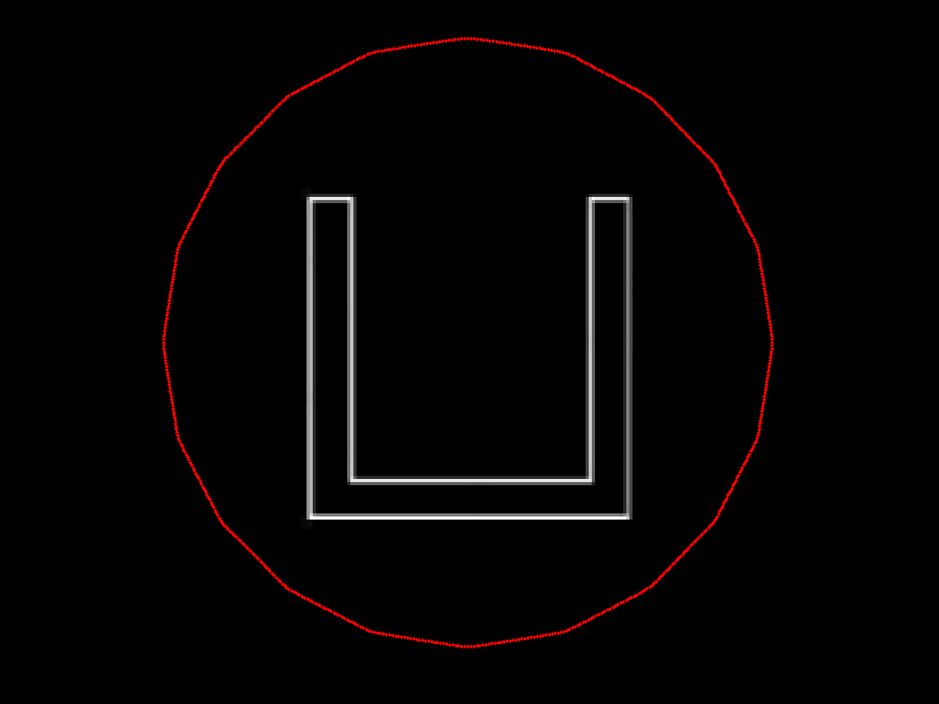
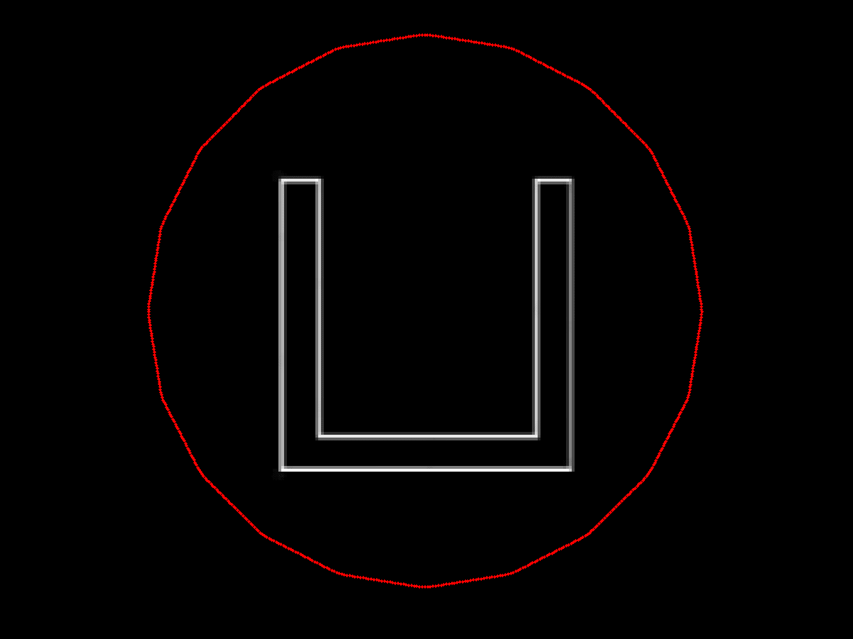
Convergence to concavities (1/2)

Slide 12
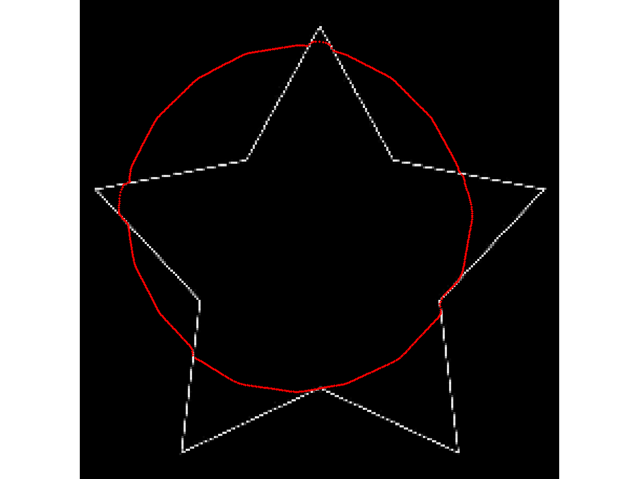
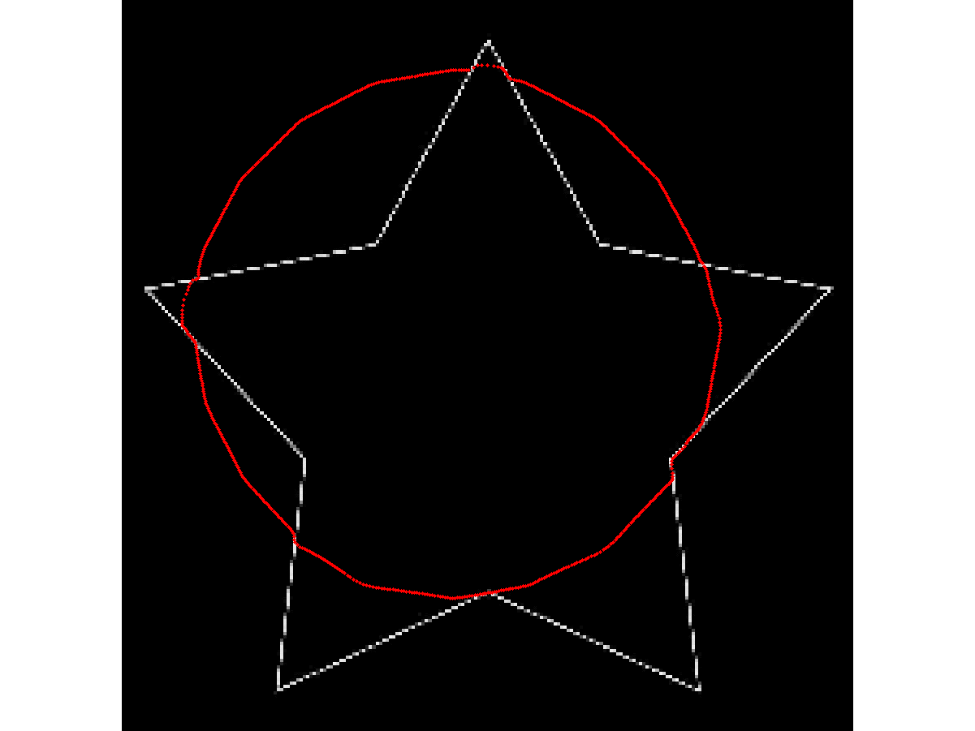
Convergence to concavities (2/2)

Slide 13
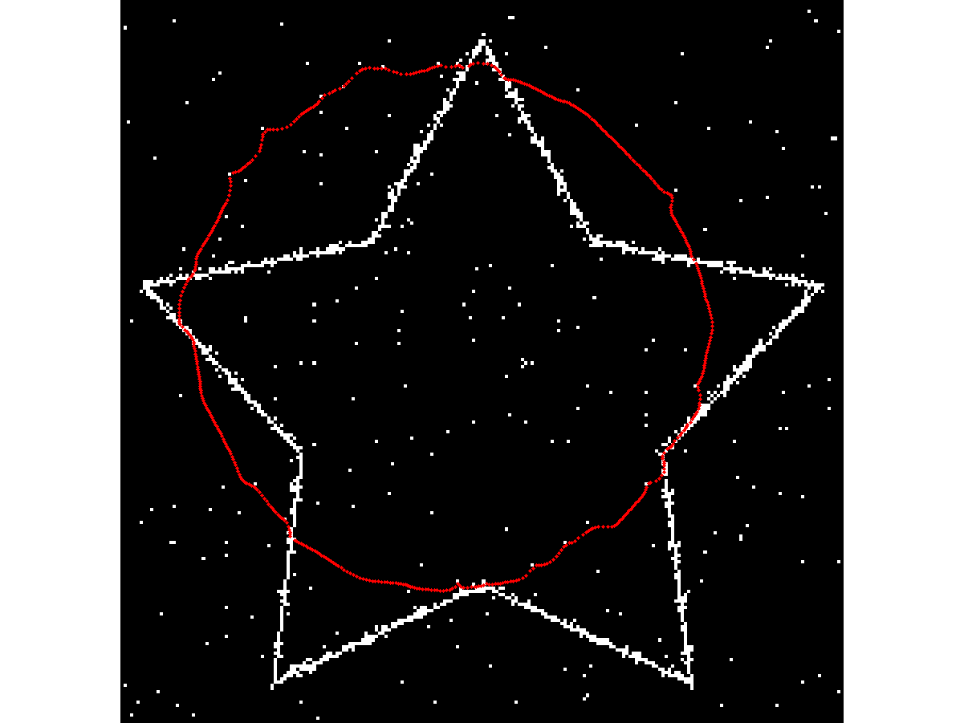
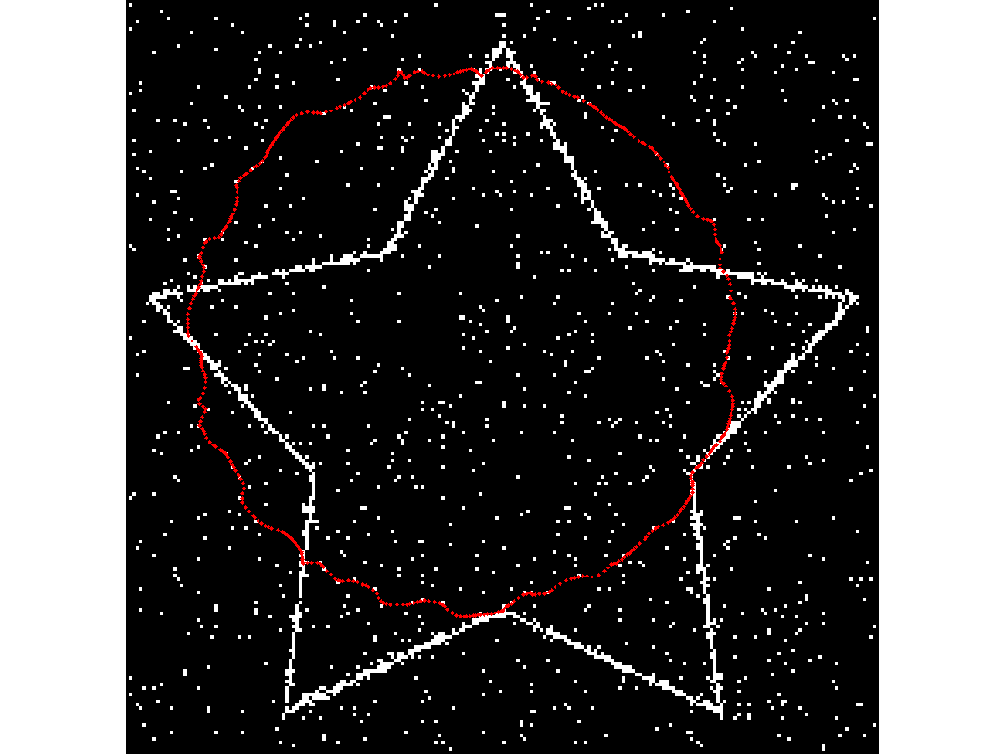
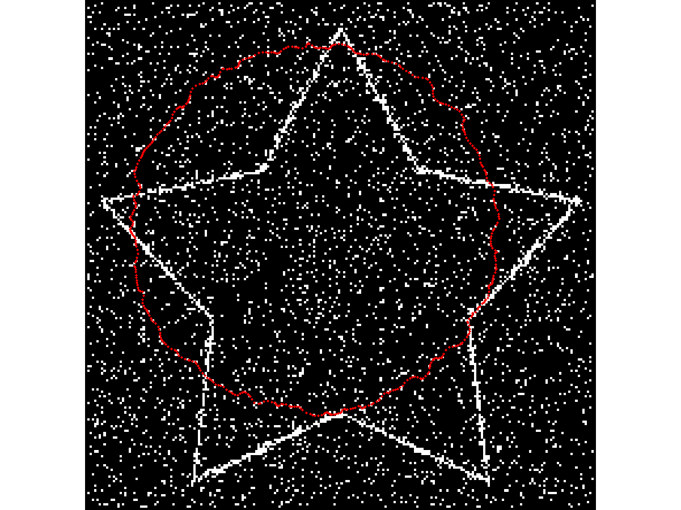
Robustness to noise : GVF with salt&pepper noise

Slide 14
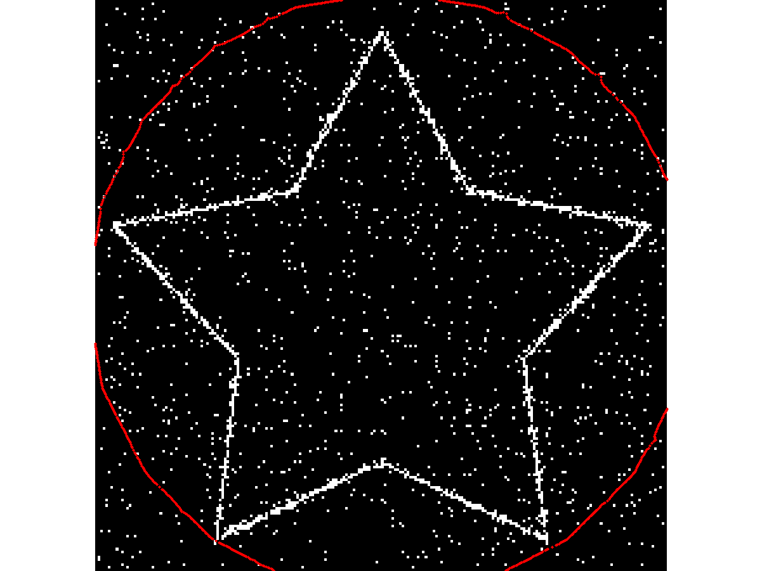
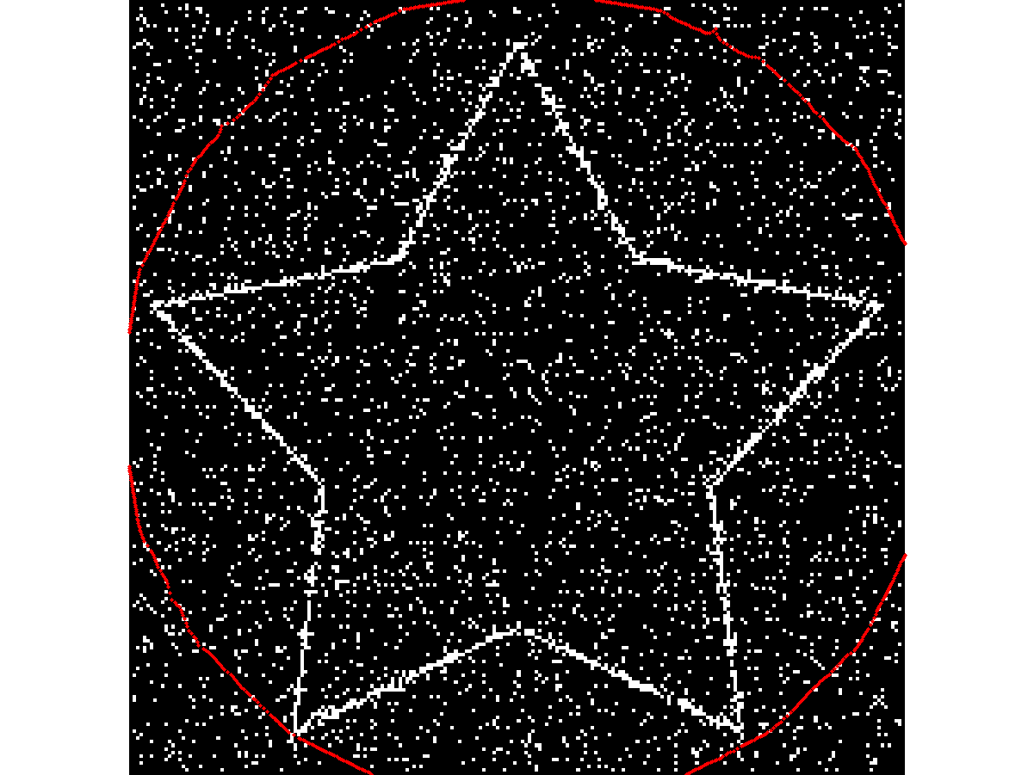
Robustness to noise : VFC with salt&pepper noise

Slide 15
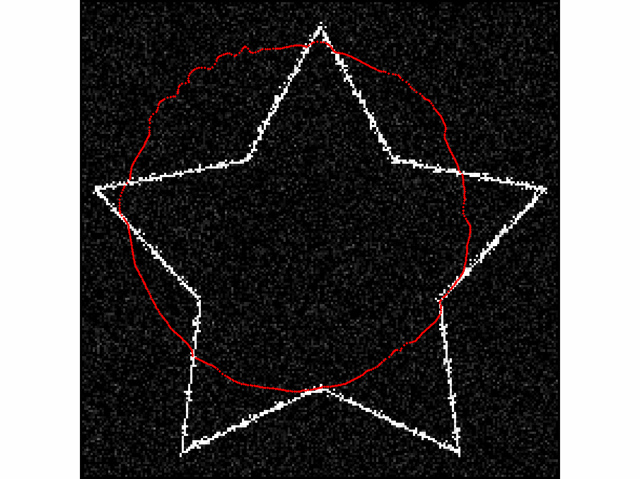
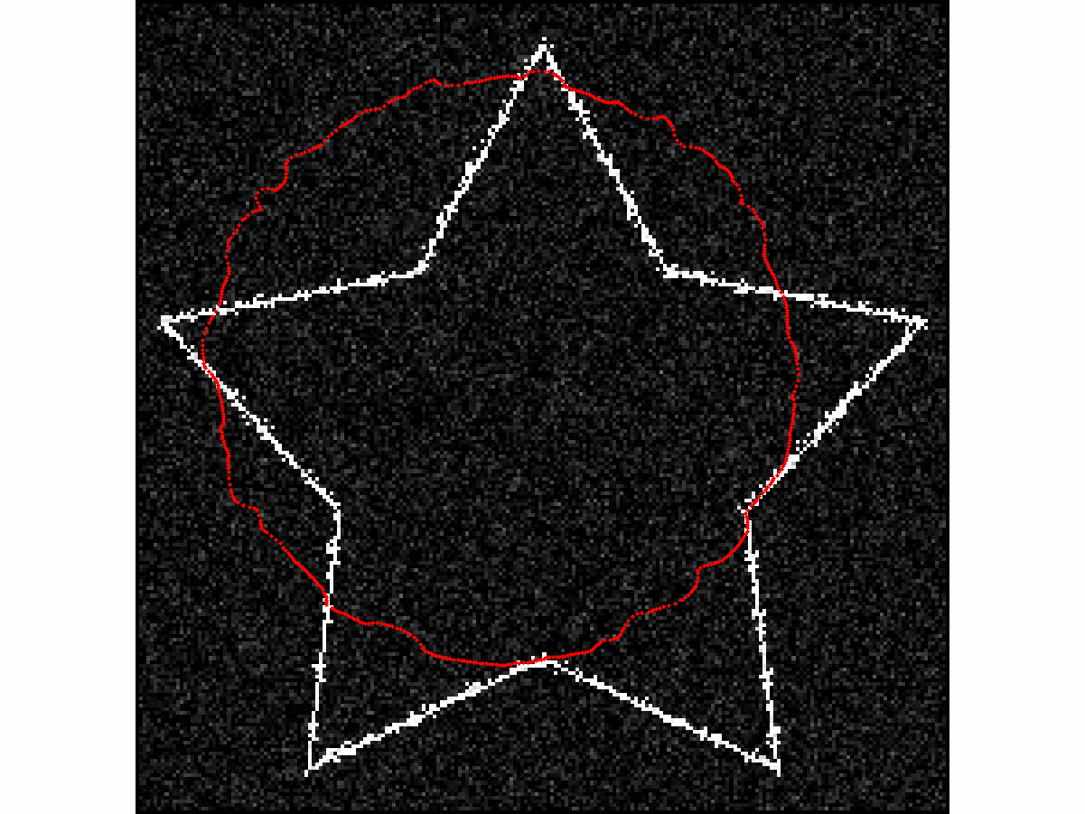
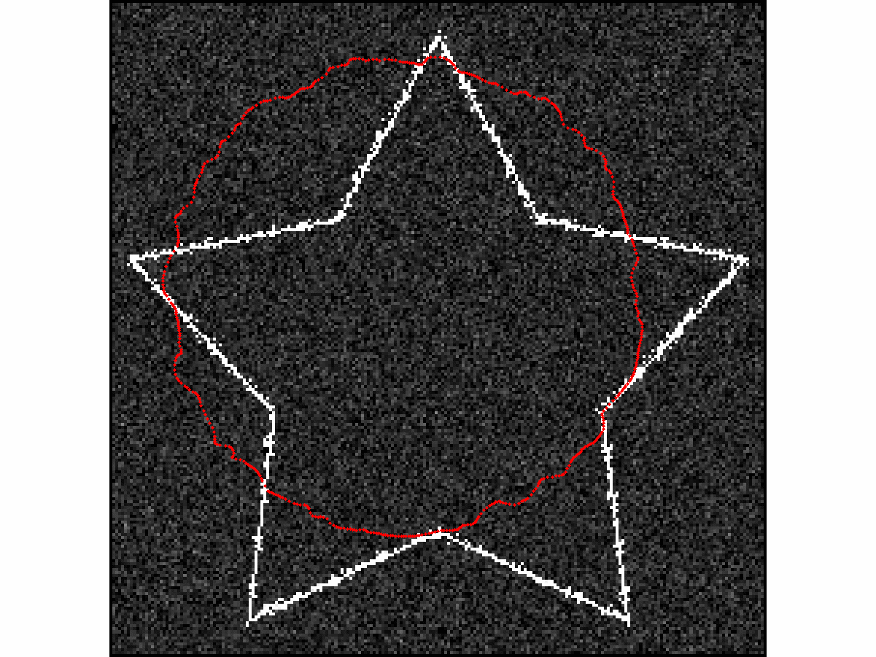
Robustness to noise : GVF with additive gaussian noise

Slide 16
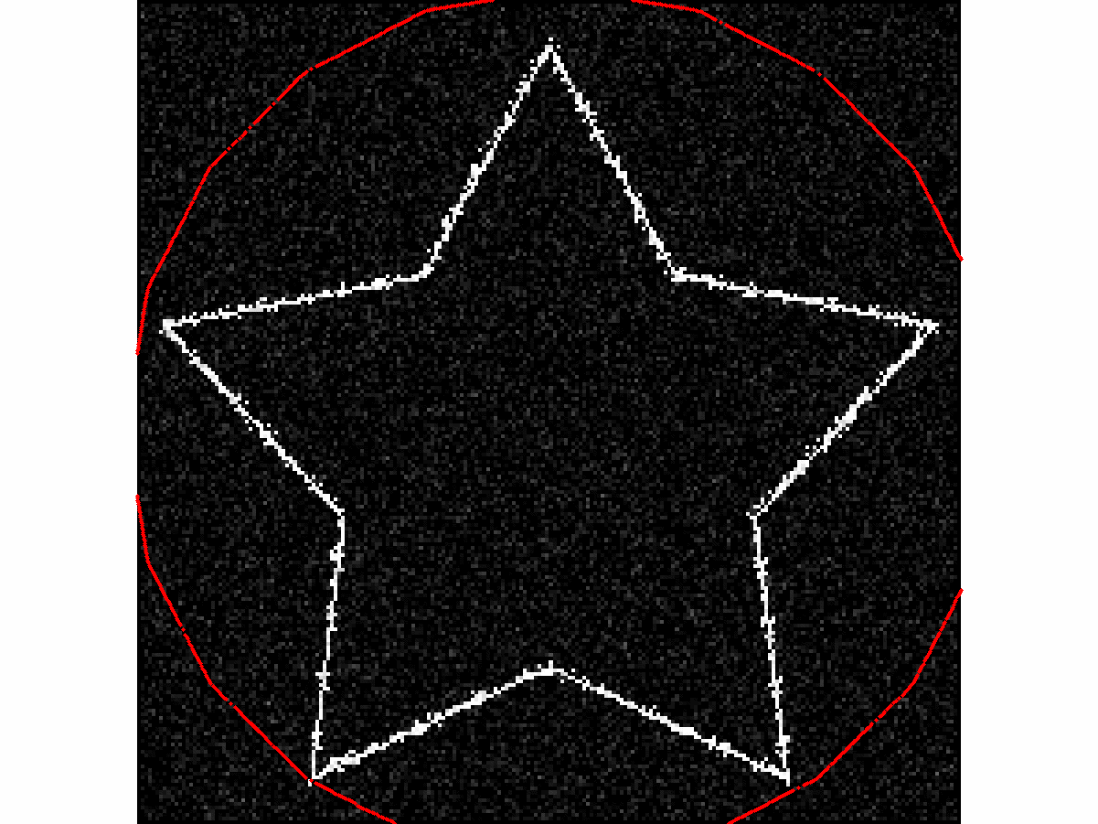
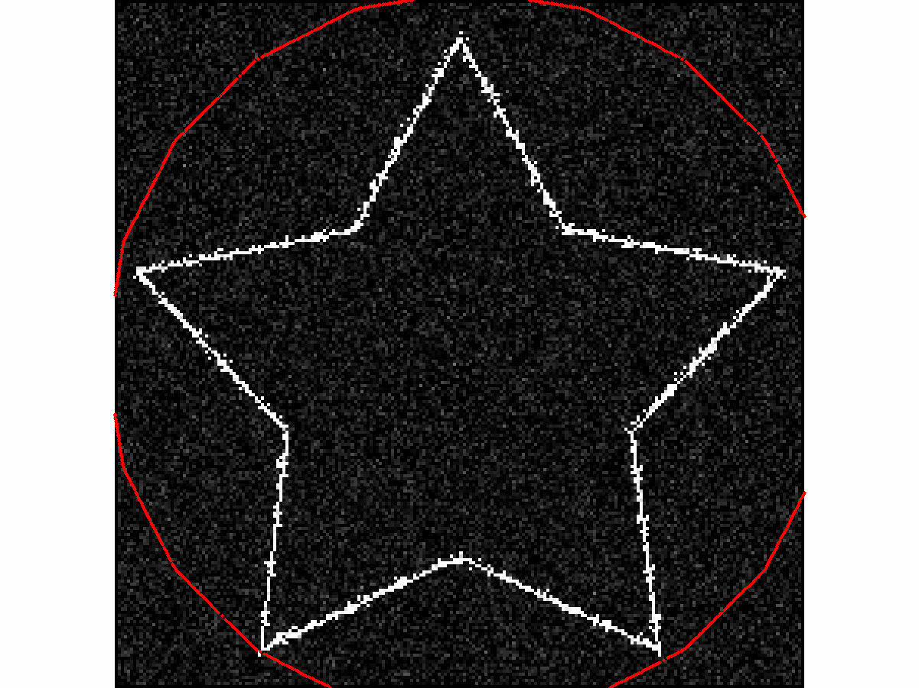
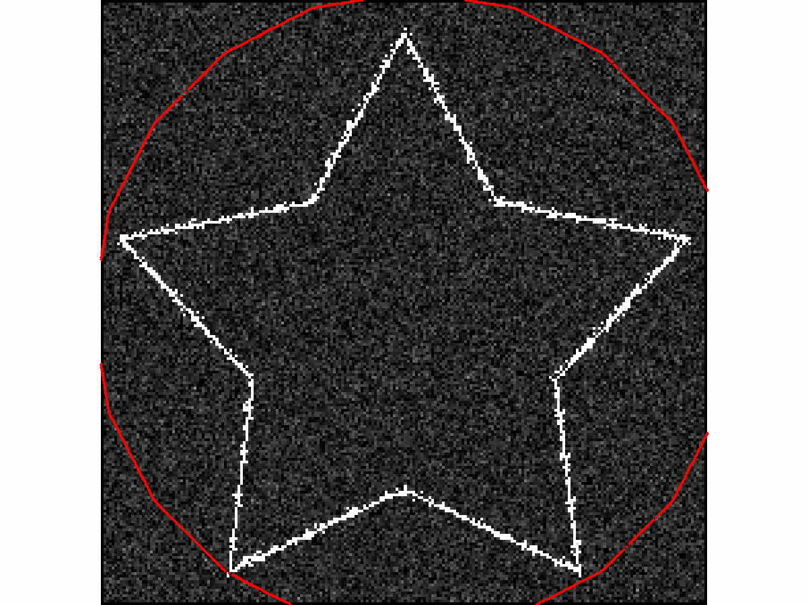
Robustness to noise : VFC with gaussian noise

Slide 17
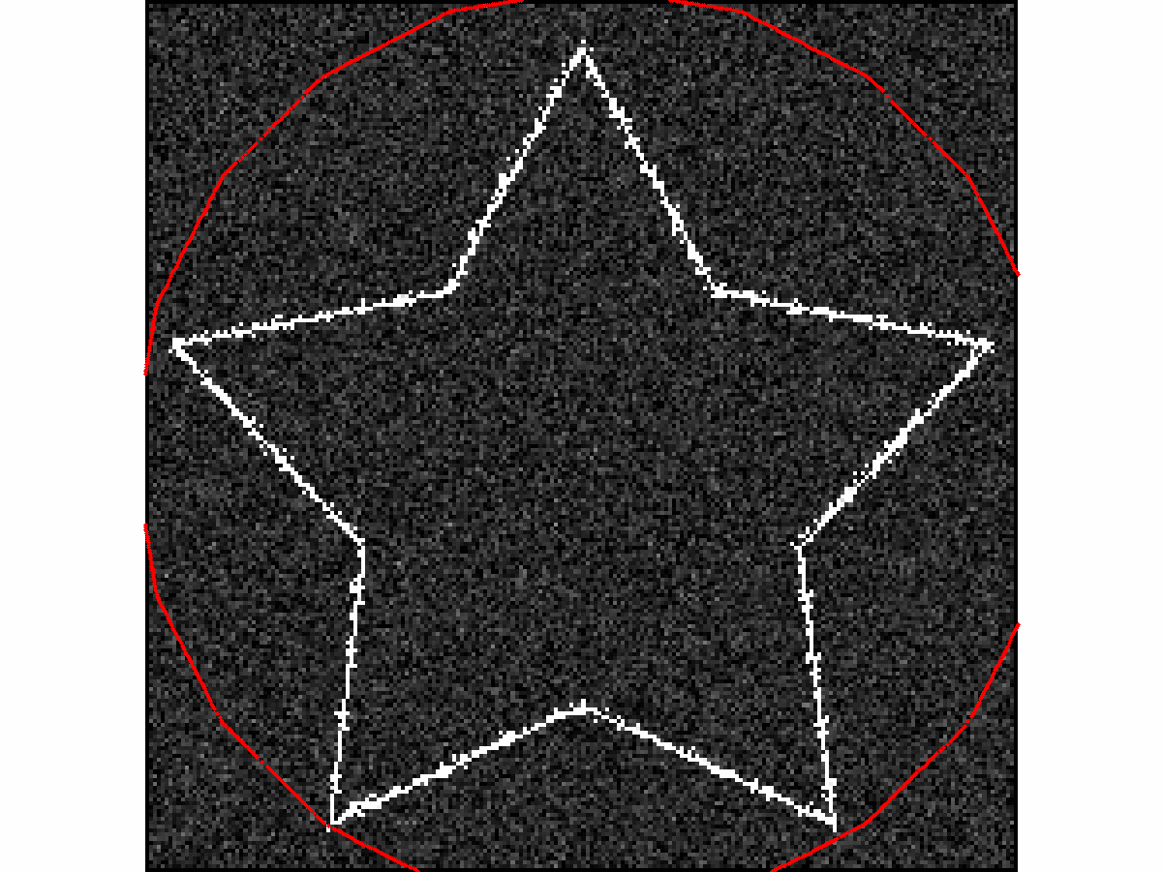
Robustness to noise : impact of the kernel radius ?

Slide 18
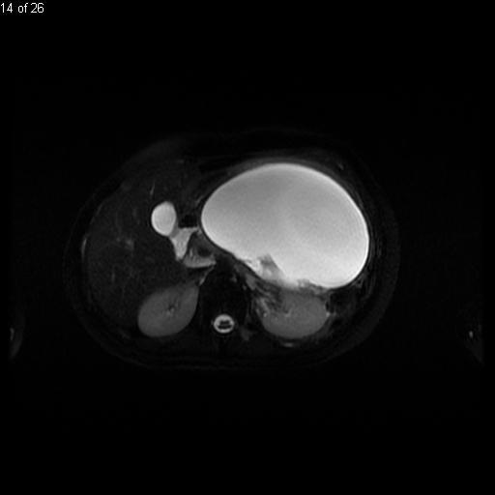
Conclusion
Capture range definition has been improves
Concavities converge property conserved
Better computational time
Better robustness to noise compared to GVF

Slide 19
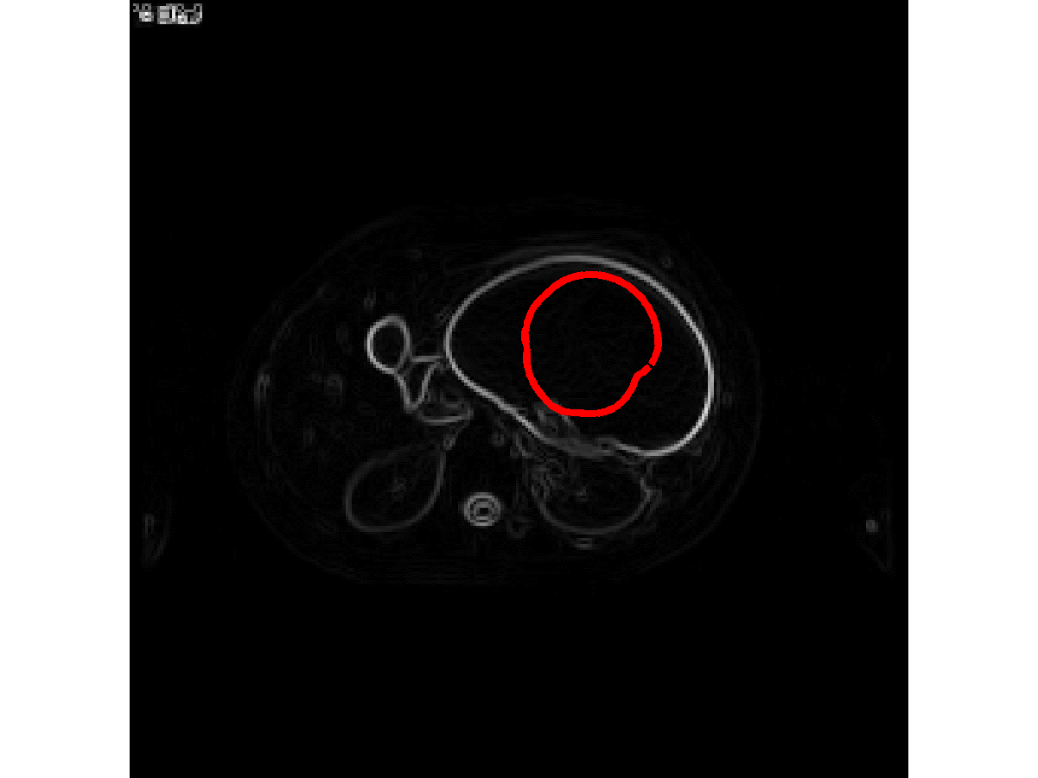
Conclusion
Capture range definition has been improves
Concavities converge property conserved
Better computational time
Better robustness to noise compared to GVF

Slide 20
Further work
Adaptative kernel
In time
With respect to the data
Multi-scale VFC to handle noise

